Slide 1


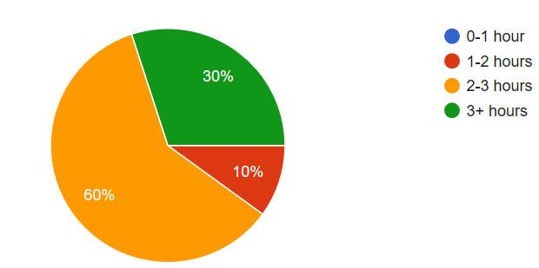
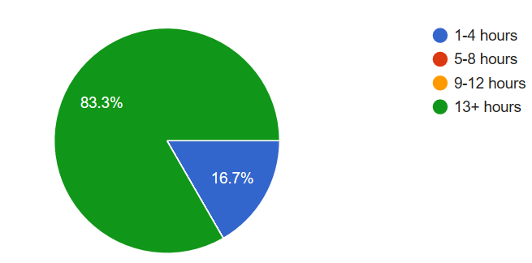

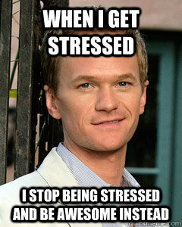

Time Management and Stress
Justin Oliveira
Burning Question
Findings and Analysis
Conclusions
I wanted to figure out if there was a difference between the time management of a college student and full-time worker and see how their mental health was affected. This led me to ask the question: How does a college student’s time management differ from a full-time worker and how does it affect their mental health?
Some college students described their week as busy, stressful, and exhausting. The amount of time spent on homework varied anywhere from 1-2 hours to more than 3 hours, but the majority of people said that that they spend 2-3 hours on homework a day. 60% of these students have to balance work on top of these duties usually spending more than 13 hours a week at work (Class survey). This data is class data.
80% of my classmates say that working/school work is the major contributor to their stress (Class survey).
(Time spent on homework)
(Time spent at work)
Interview of a Student
Most weekdays are spent in class and working.
She does homework on weekends along with recreation.
She typically spend a lot of time on homework and spaces
out larger projects to reduce stress. Work causes a medium
stress level and it would not change with less work (Miceli).
Interview of a Professor
She works 50 hours a week. She does aerial
classes on the weekends. Teaching is more stressful
than her second job because it requires more time (Garcia).
Time management is and is not contributor to stress. While many college students say they are stressed due to work load and their time management, some say they are not affected. Full-time workers also say they are not affected by time management. Full-time workers are also usually able to cope with their stress more easily and regain control over their mental state as opposed to college students. Recent studies like these shed new light on how college students might actually be more stressed out than full-time workers, which previous studies have not addressed. At first glance, teenagers might say that full-time workers are more stressed due to taxes, supporting families, and maintaining good health. But on closer inspection college students might be more stressed out due to the fact that it is harder to cope with the higher work load than a full-time worker who may be used to it.
Existing Knowledge, Research and/or Views
There are many different ways you can manage your time. “ A key to better time management is completing tasks within the allocated time frame so that it gives you more time to complete other tasks or have more leisure time” (Tourangbam 3).
“Rushing blocks thoughtful communication and creates worries among colleagues” (Shellenbarger).
“Sometimes saying that you work between 60-70 hours a week could be a sign that you may not be spending your time efficiently” (Tourangbam 2).
Data collected from 525 employed men and women indicated that use of time management behaviors was negatively affected by strain (Elaqua and Jex).
Sources
Class Survey. 21 October 2018.
Garcia, Jennifer. Personal Interview. 10 October 2018.
Jex, Steve M., and Tina C. Elacqua. “Time
Management as a Moderator of Relations between Stressors and Employee Strain.” Work &; Stress, vol. 13, no. 2, 1999, pp.
182–191.
Miceli, Madison. Personal Interview. 4 October 2018.
Shellenbarger, Sue. “The Problem With Busy
Colleagues: Secondhand Stress.” Wall Street Journal, 2013, p. D.1.
Time Management. Vij Books India, 2011.
Methodology
I used library research in order to gain a better understanding of time management as a topic and to gather some background information.
I then conducted two interviews with a college student and a professor in order to get first-hand information from people who actually have to juggle time management.
I conducted a survey of my class to give me more accurate data regarding college student time management rather than just one source.
Artistry
The information from my research that will be used in my video is that your time needs to spread out accordingly, and to not do everything at once. I will also include that usually if someone around you is stressed then you tend to become more stressed.

