Slide 1




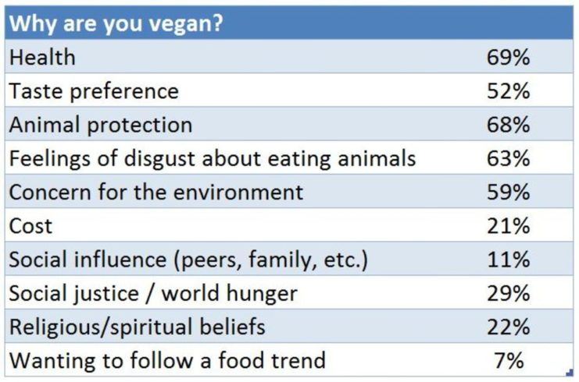


Is eating vegan food actually an effective diet?
Chanya Champagne
Burning Question
Findings and Analysis
Conclusions
Is eating vegan food an effective diet?
Many people throughout the years have increasingly joined the vegan lifestyle for environmental, ethical, and health reasons. However, is it really as beneficial as they say?
Living vegan has many advantages. First, it’s a direct action you can take right now that has an immediate, real-world impact on animals. Secondly, living vegan is better for the environment. Finally, a vegan diet is so healthy for you. With so much misinformation on the internet today, it’s easy to see how people can become confused about what being a vegan means. In short, vegans avoid animal meat, animal products, and dairy in their eating routine. Vegans also avoid animal products in bedding items, cleaners, clothing and beauty products. After doing research and learning more about the vegan life and how it works, I can truthfully say that eating vegan is the way to go. After asking multiple college students if they would go vegan, my hypothesis was correct. I figured that students on campus wouldn’t want to go vegan simply because they don’t know the benefits. Personally, I am not sure I’d ever take the initiative to go vegan but it’s definitely something I would consider in the long run.
This is a graph displaying my results
from asking 25 random students on campus
would they go vegan. Out of the 25 people I asked,
20 people said no and only 5 people said yes.
Existing Knowledge
Vegan foods are free of all animal products such as meat, eggs, fish, and dairy.
Approximately 5% of the US is vegetarian (close to 16 million people), and about half of those are vegan -- meaning about 7.5 million Americans abstain from all animal products.
Research
Why go vegan?
Vegan living often reduces the intake of saturated fat, animal hormones, and cholesterol while increasing the intake of fresh fruits and veggies.
Vegans ted to have lower rates of cancer than meat eaters and vegetarians. For example, vegan women had 34% lower rates of female-specific cancers like breast, cervical, and ovarian cancer. Similar results were found in men for prostate cancer.
Promotes weight loss since individuals are not consuming meat or dairy.
Observational studies report vegans may have up to a 75% lower risk of developing high blood pressure.
This demonstrates how people don’t know and aren’t aware of the benefits of going vegan. Research and studies prove how going about a vegan lifestyle is healthier and beneficial to the human body. However, people simply don’t know and seem to don’t care to know either.
Existing Knowledge, Research and/or Views
Sources
Participants in the study were asked about their motivations for eating a vegetarian/vegan diet. A great many people indicated that they are vegan for health, taste, and humanitarian reasons.
Davis, Brenda and Vesanto Melina. The Complete Guide to Adopting a Healthy Plant-Based Diet. Book Publishing Company, 2000, www.brendadavisrd.com/books/.
Garner, Gary and Robert. “11 Facts About Vegan Living.” DoSomething.org | Volunteer for Social Change, Columbia University Press, 2010, www.dosomething.org/facts/11-facts-about-vegan-living.
“Is 2014 the Year of the Vegan?” One Green Planet, 19 Jan. 2014, www.onegreenplanet.org/news/is-2014-the-year-of-the-vegan/.
Alfvegren, Helen. “Vegan Demographics 2017 - USA, and the World.” Vegan Bits, 19 May 2018, veganbits.com/vegan-demographics-2017/.
Methodology
Interviews with Experts
Having a one on one interview with experts helped me put things perspective and put myself in a vegan’s shoes and see things from their outlook. I learned that vegan food has many benefits and a lot of people agree with the lifestyle.
Internet Research
The internet helped me differentiate the pros and cons to eating vegan. There were many opposing views but people agreed more with the lifestyle than disagreed.
Library Research
I discovered many studies and facts about vegan living. It helped me compare and contrast what experts said, what normal college students think, and what is actually factual.
I also went around campus and asked 25 random students asking them would they go vegan to demonstrate the misconception of going vegan.
Artistry
Do similar skit to Adam Ruins Everything and use findings and verify the accuracy of each statements.
In our groups video, my topic was brought up and discussed in the beginning of the video after the introduction. In the featured skit, I play myself and I am at Dunkin Donuts drinking an iced coffee and a toasted plain bagel with cream cheese. Soon after, one of my group members which is Justin, who plays “Adam” in the skit appears and begins to discuss a couple facts about vegan food and why I should go vegan.

